Slide 1
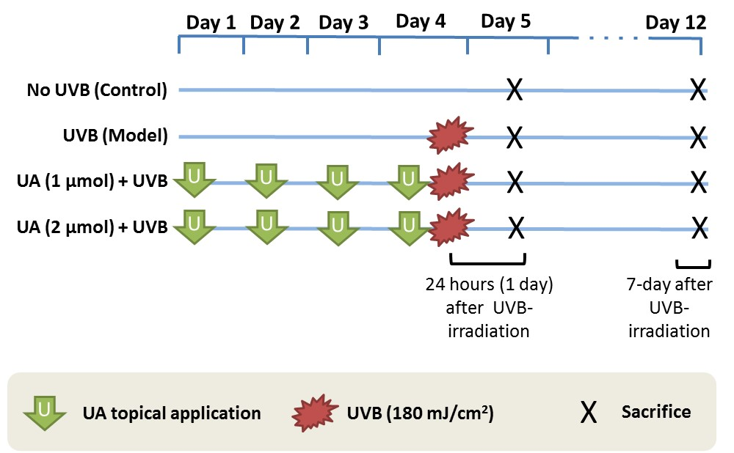
Selected for NGS

Slide 2
Bisulfite-seq
Sample | Renamed | Reads
1_day_UVB-1_S7_R1_001.fastq.gz | UVB_0_0 | 28872393
1_day_UVB-2_S8_R1_001.fastq.gz | UVB_0_1 | 26178090
1_wk_Ctrl-1_S1_R1_001.fastq.gz | Ctrl_1_0 | 33233637
1_wk_Ctrl-2_S2_R1_001.fastq.gz | Ctrl_1_1 | 28810810
1_wk_UVB-2_S3_R1_001.fastq.gz | UVB_1_0 | 29406096
1_wk_UVB-3_S4_R1_001.fastq.gz | UVB_1_1 | 25511293
1_wk_UAH_UVB-3_S5_R1_001.fastq.gz | UAH-UVB_1_0 | 28424812
1_wk_UAH_UVB-4_S6_R1_001.fastq.gz | UAH-UVB_1_1 | 26805411

Slide 3
RNA-seq
Sample | Renamed | PE Reads
1_day_UVB-1_S7_R1/R2_001.fastq.gz | UVB_0_0 | 17405694
1_day_UVB-2_S8_R1/R2_001.fastq.gz | UVB_0_1 | 15895064
1_wk_Ctrl-1_S1_R1/R2_001.fastq.gz | Ctrl_1_0 | 17136717
1_wk_Ctrl-2_S2_R1/R2_001.fastq.gz | Ctrl_1_1 | 17741002
1_wk_UVB-2_S3_R1/R2_001.fastq.gz | UVB_1_0 | 16190431
1_wk_UVB-3_S4_R1/R2_001.fastq.gz | UVB_1_1 | 17771987
1_wk_UAH_UVB-3_S5_R1/R2_001.fastq.gz | UAH-UVB_1_0 | 14622578
1_wk_UAH_UVB-4_S6_R1/R2_001.fastq.gz | UAH-UVB_1_1 | 16291824

